Slide 1
T5.2 Use case#1: Smart city analytics
Hélio Simeão (UBI)

Slide 2
Overview of Task T5.2 Smart City UC
Task leader: UBI
Timing: M10 (Oct’23) - M36 (Dec’25)
Related deliverables and due dates
Efforts
D# | Deliverable Title | Lead beneficiary | Type | Level | Due date
D5.1 | Use case definition and initial platform integration | UBI | DEM | PU | M15 (Mar’24)
D5.2 | Refined platform integration and experiment results | UBI | DEM | PU | M22 (Oct’24)
D5.3 | Final platform integration and experiment results | UBI | DEM | PU | M36 (Dec’25)
Task | UBI | TSI | CNR | HPE | AEGIS | CAM | TOTAL
T5.2 | 20 | 4 | 3 | 2 | 10 | 5 | 44

Slide 3
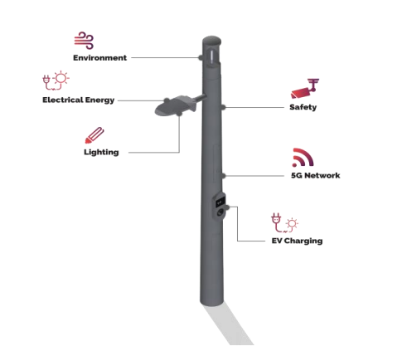
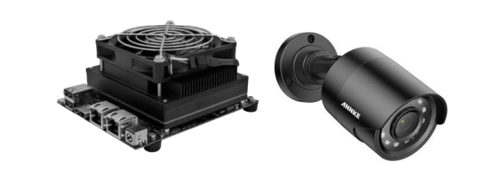
T5.2 Smart City UC: Description of the pilot infrastructure
Smart Lamp Post
Jetson Board
CCTV Camera

Slide 4
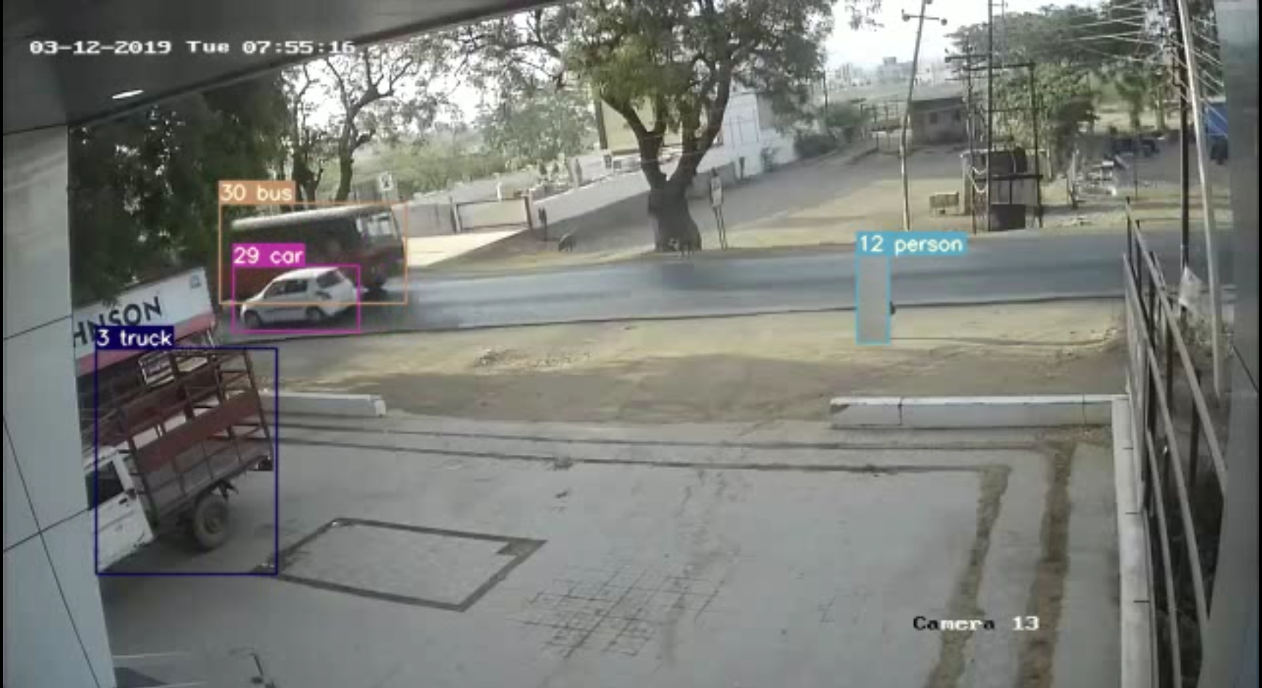
T5.2 Smart City UC: Overview
Detection:
YOLO CV model that detects cars, people, etc
The model will out the counter of each class through Redis and can additionally save the video

Slide 5
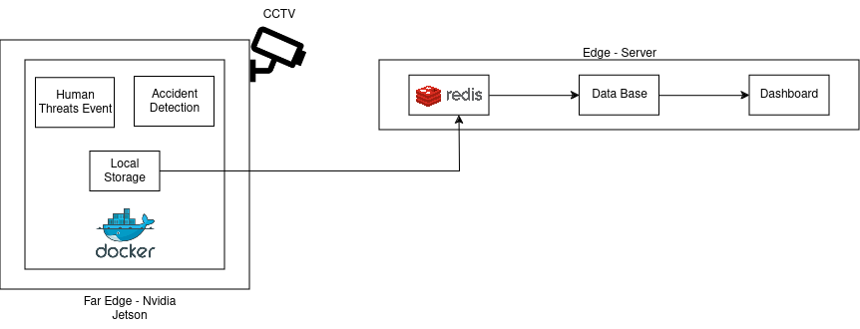
T5.2 Smart City UC: Overview

Slide 6
T5.2 Smart City UC: Status at M18
Available Jetson Xavier is not working, acquiring a Jetson Orin to proceed with the UC
Deployment of Edgeless con, orc and Edgeless node.
Use Case workflow is defined
Currently developing the processing function and camera resource (debugging and troubleshooting in progress with TUB and CNR)

Slide 7
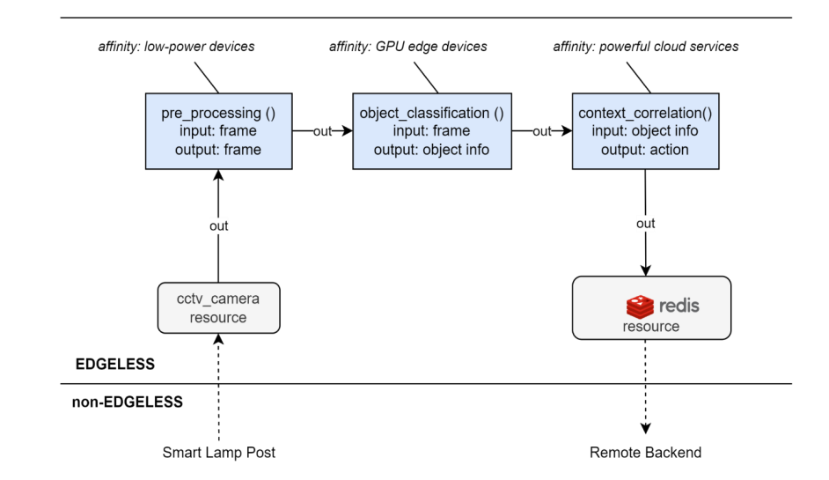
T5.2 Smart City UC: Edgeless workflow

Slide 8
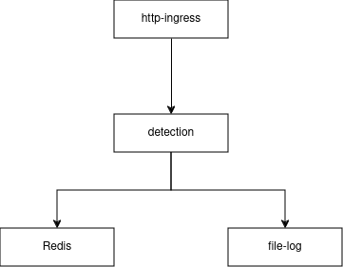
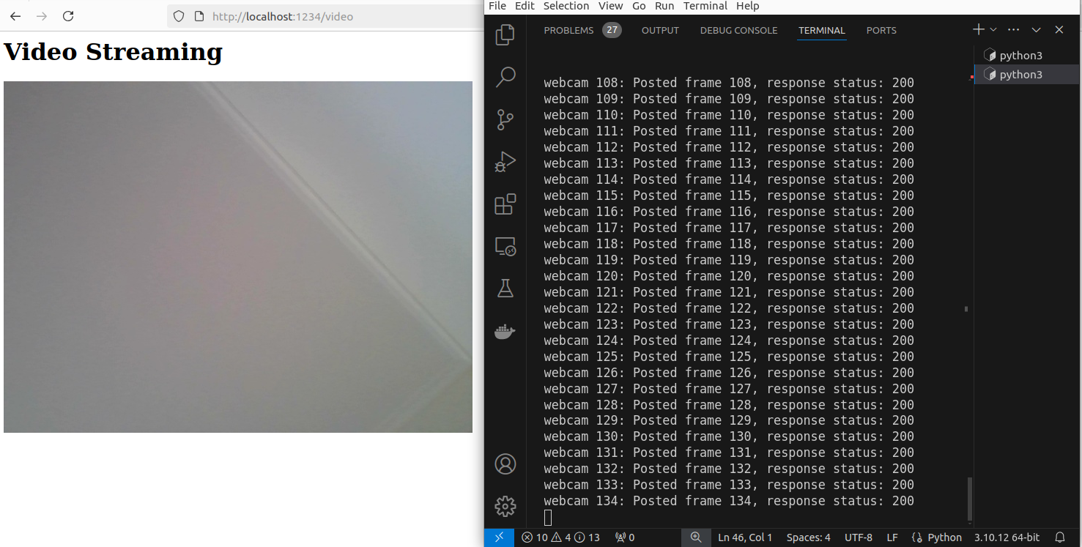
T5.2 SmartCity UC: preliminary testing
Camera resource:
Developed a code that would post the frames into a URL (currently a localhost) with flask.
Since http-ingress resource handles http commands, we post it to the host link

Slide 9
T5.2 SmartCity UC - Next Steps (M18-M36)
Finish the development of the processing function
Test the developed workflow in the NVIDIA Orin
Integrate with AEGIS App (expose video stream)
Test and validate Edgeless at the laboratory setup
Deployment at the UC location
Test and validate Edgeless at UC location

